Slide 1

Team : 06
Food brand understand customer trend
GUIDANCE BY : PAVITHRA KANNAN MAM

Slide 2




Team Members
JAGRUTI DESALE
SANSKAR CHOUDHARI
ADITYA SINGH

Slide 3

Project Introduction
Food delivery platforms like Swiggy and Zomato generate huge volumes of customer feedback in the form of ratings, reviews, and order data. This feedback contains valuable insights about customer preferences, satisfaction levels, and product performance. However, businesses often fail to leverage this raw data effectively due to its unstructured nature.
Our project aims to analyze customer feedback using Power BI to transform ratings into meaningful insights. We classified customer feedback into Positive, Average, and Negative sentiments, enabling a deeper understanding of customer experiences.

Slide 4
Project Overview
Focus on analyzing customer behavior toward food brands using collected data.
Utilized Power BI for visualization and analysis.
Identified seasonal trends, demand patterns, and brand performance.
outcome
Understanding customer preferences for better business decisions.

Slide 5
Key Features
Collection & preprocessing of sales and customer feedback data.
Sentiment analysis (Excellent>4.5, Good>4, Average>3.5, Poor).
Price categories (Low: <300, Medium: 300-600, High: >600, premium: >1000)
Delivery Speed (Fast: <45 Min, Medium: 46-60 Min, Slow: >60 Min)
Interactive Power BI dashboards with charts, filters, and drill-downs.
Price-wise and product-wise comparison.
Region-based and demographic insights.

Slide 6


Milestones
Data Collection & Cleaning
Structured Dataset Creation
Dashboard Development
Insights & Recommendations
Power BI dashboard with :
Product-wise sentiment analysis
Region-wise preferences
Time-based sentiment trends
Outputs Delivered

Slide 7
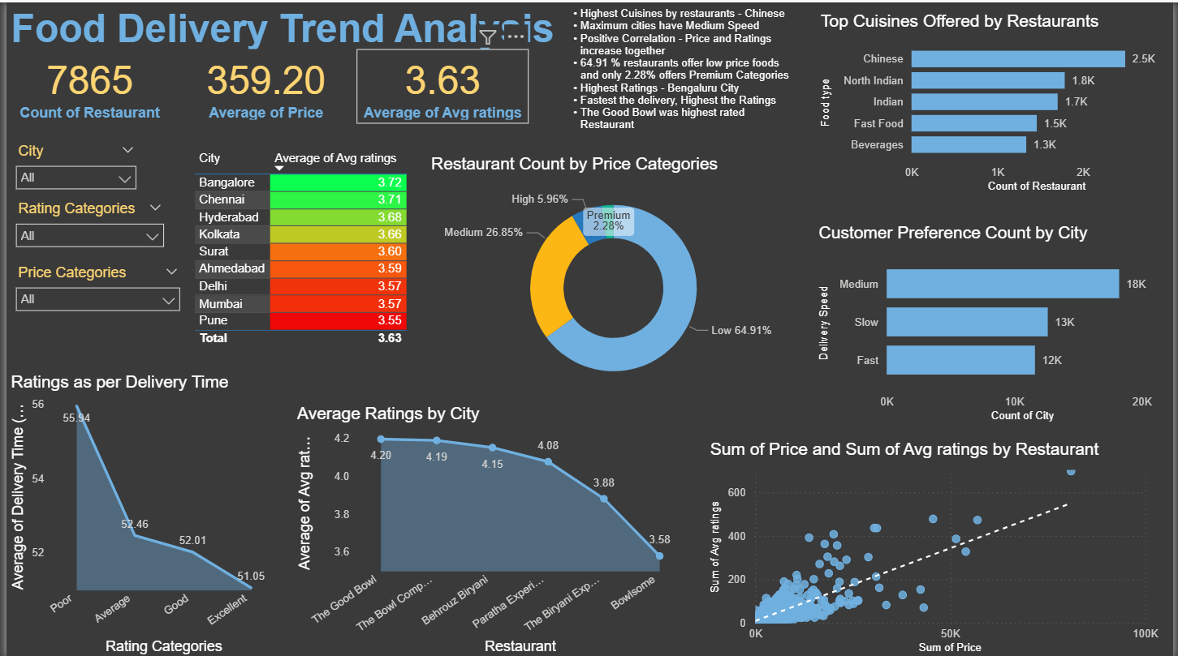
Dashboard overview
Key Insights :
City-Wise Ratings
Pune (3.55) & Mumbai (3.57) are the lowest → signals need for service/menu improvement.
Price Category Distribution
64.9% of restaurants fall in low price → highly price-sensitive market.
Only 2.28% restaurants serve premium segment → untapped opportunity for premium offerings.
Cuisines Popularity
High demand in Indian metros, but over-saturation risk in Chinese category.
Delivery Time & Ratings
Faster delivery = higher ratings.
Poor/slow delivery time strongly reduces customer satisfaction.
Food Delivery Trend Analysis

Slide 8
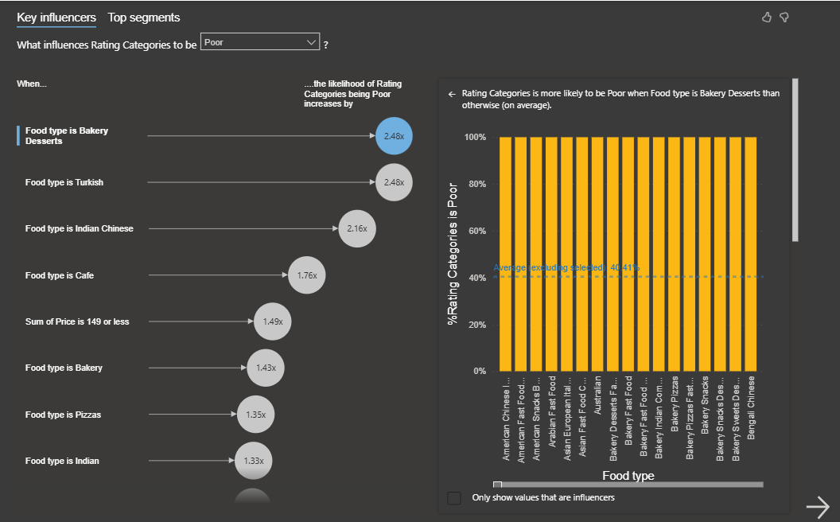
Dashboard overview
Key Influencers
Key Insights :
Food Categories Linked to Poor Ratings
Bakery Desserts → 2.48x more likely to receive poor ratings.
Turkish & Indian Chinese food → consistently underperforming in customer feedback.
Cafes & low-cost bakery items also prone to dissatisfaction.
Price & Quality Issue
Lower price ranges are associated with poorer feedback, possibly due to compromises in quality or service.

Slide 9
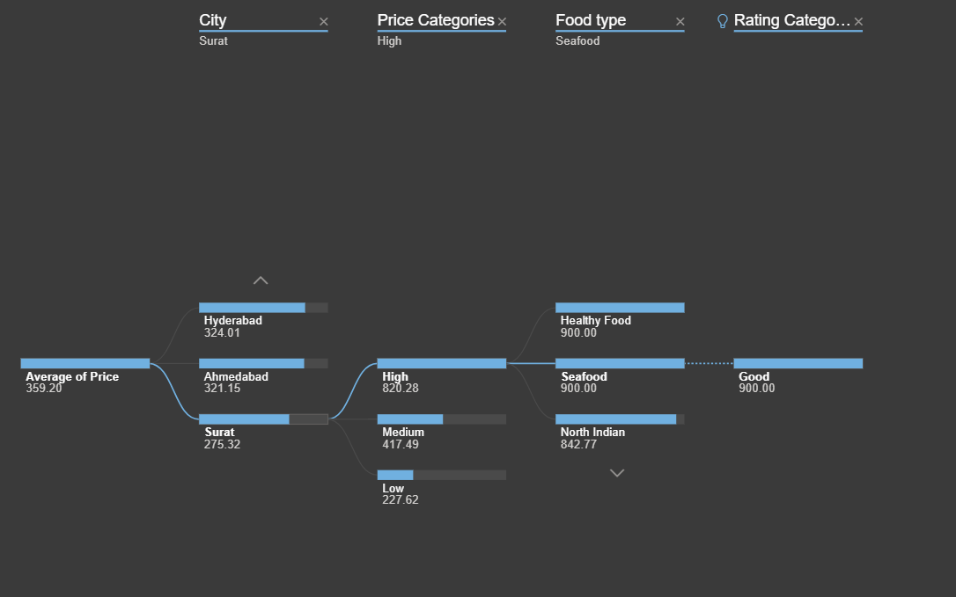
Dashboard overview
Decomposition Tree
Key Insights :
City-Level Pricing Differences
Surat has the lowest average price (275), while other cities like Hyderabad (324) and Ahmedabad (321) are higher.
Indicates regional pricing sensitivity — what works in one city may not in another.
Impact of Price Categories
High-priced restaurants (~820 average) consistently earn better ratings.
Medium and Low-price categories often correlate with average to poor reviews.
Food Types That Drive Good Ratings
Seafood and Healthy Food under High Price earn excellent ratings.
Suggests customers are willing to pay more for premium, health-focused, and niche food types.

Slide 10
IMPACT
Enabled restaurants to track customer satisfaction more effectively.
Highlighted seasonal and regional food trends
Identified problem areas (e.g., low ratings due to delivery issues).
Provided a data-driven decision-making tool for food businesses.

Slide 11


Thank you
Team : 06
We appreciate the opportunity to present our project on Customer Sentiment & Food Trend Analysis. Your feedback and suggestions will help us improve and take this work further.
Thank you for your time and attention!

